Slide 1

Project Cyclistic

Slide 2
Project objective:
• Maximize anual membreship.
• Convert cyclist to occasional members.
Key factors to analyze:
• User frequency.
• Days and hours.
• Start and end stations.
• Trip duration.
• Reasons for use.
Bussiness Task:
• Analyze user differences.
• Identify opportunitites to convert them.
• Create data-driven strategies.

Slide 3
About the Data Sample
The data presented corresponds to a representative sample of all the data collected over the course of a year by the company Cyclistic.While the absolute values may seem few, they were carefully selected to ensure a reliable and statistically valid analysis.
The purpose of this visualization is to illustrate usage patterns, tendencies and opportunities.

Slide 4
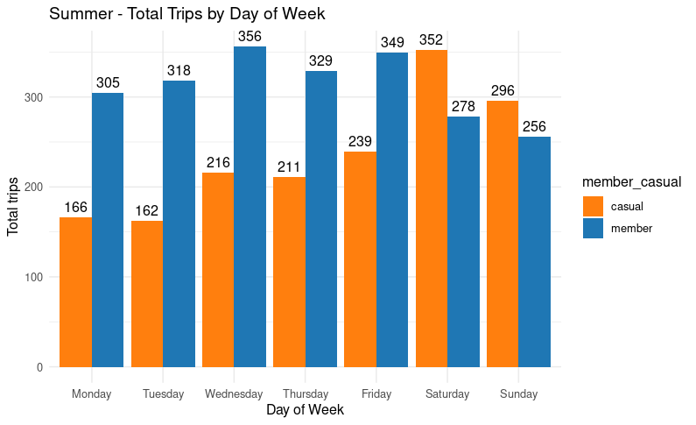
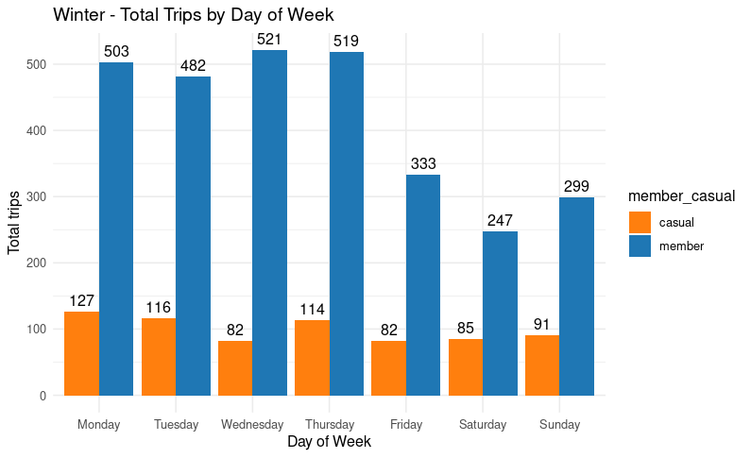
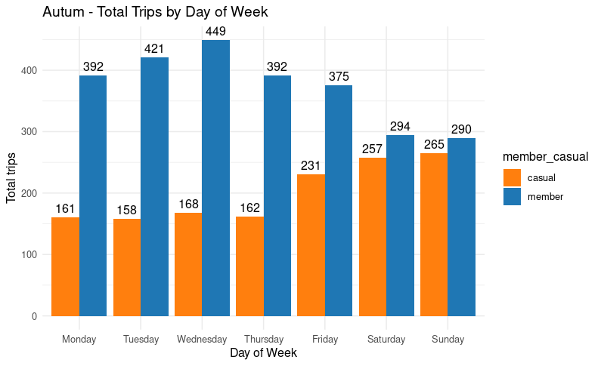
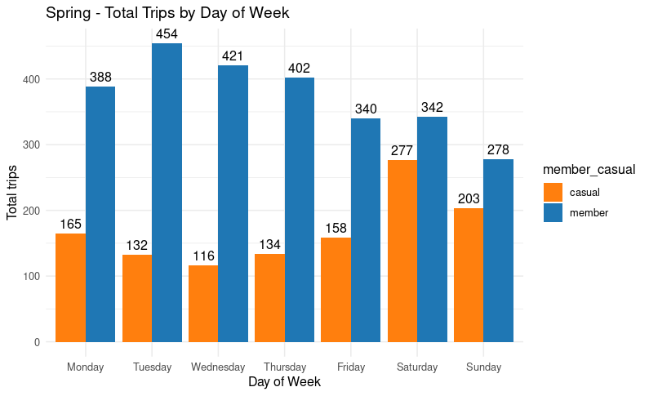
Total trips per day of the week by season
• Partners show more consistent usage every day of the week in all sesasons.
Occasional users increase their usage on Fridays, Saturdays and Sundays, especially in summer and autum.
In Winter, they are les active, especially among the occasional ones.
Weekends and warmer months:
Increased presence among casual members.
Campaign focused on sesasonal promotions.
Stable membreship usage throughout the year:
Maintain current benefits.
Low activity in Winter:
Opportunity to launch special discounts for new membreships during those months.

Slide 5
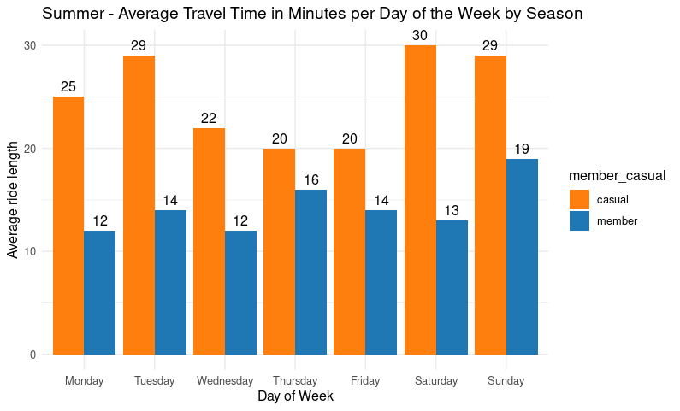
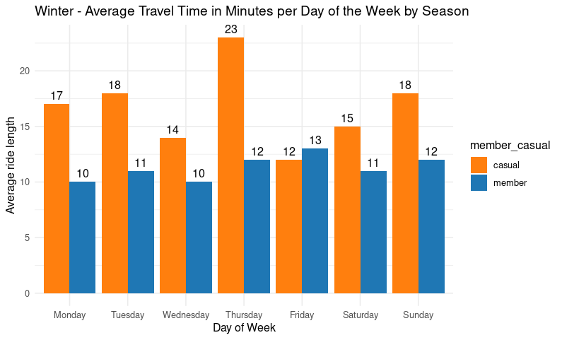
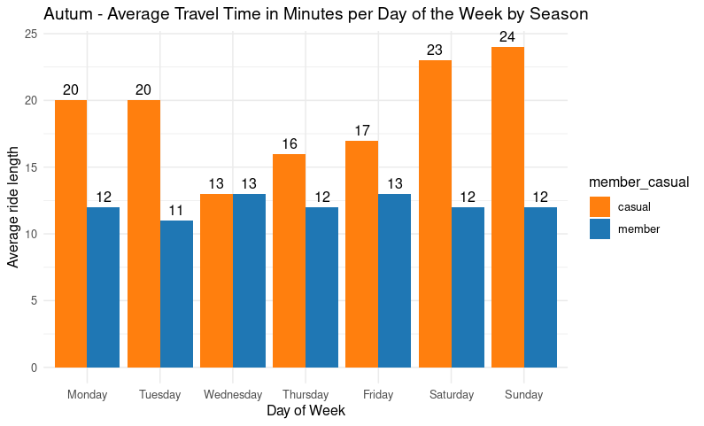
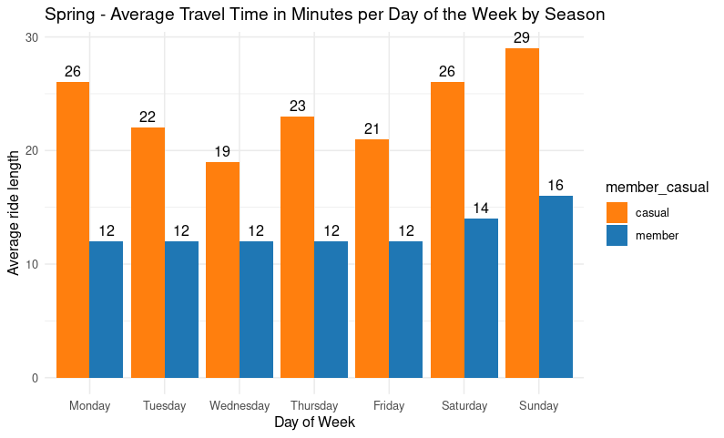
Average travel time per day of the week by season
•In summer and spring, the users casuals tend to make longer trips, especially on weekends.
• In Winter travel times decrease significantly (between 12 and 18 minutes), except on Thursdays.
• Saturdays and Sundays are consistently the days with the longest trips, in all seasons.
• Wednesdays and Fridays in Winter are the days with the shortest average journey time.

Slide 6
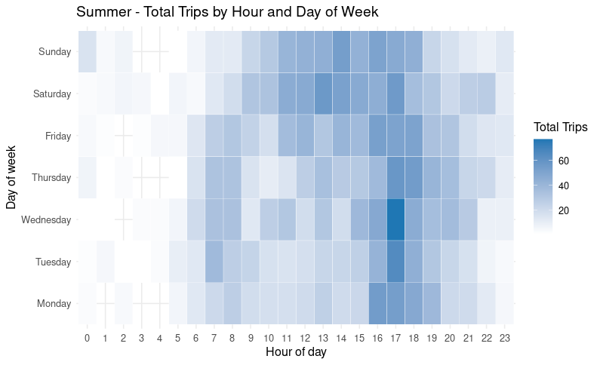
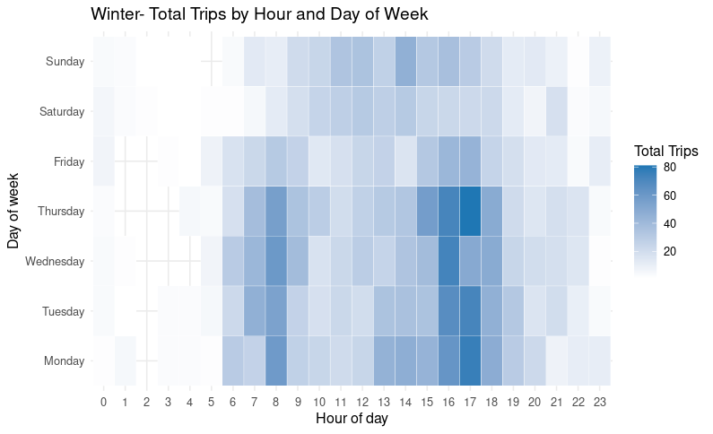
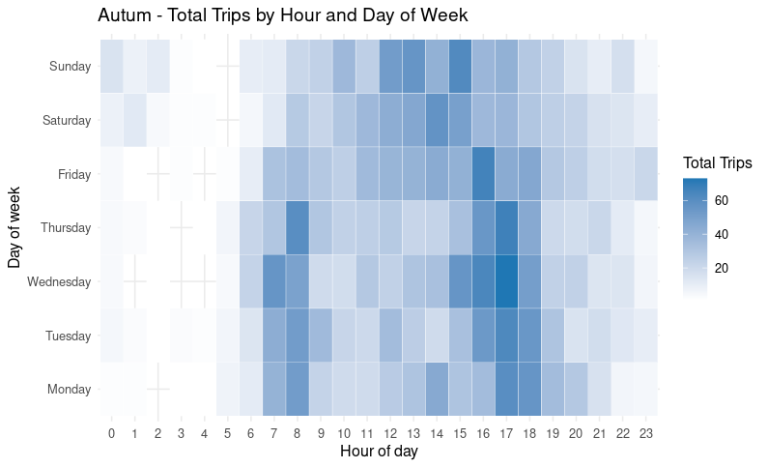
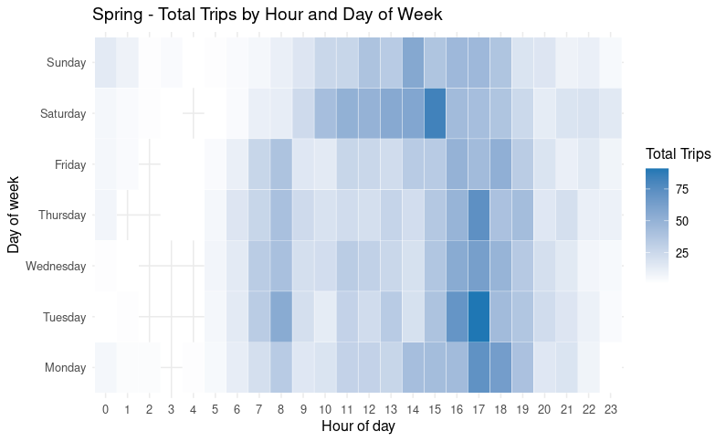
Total trips per hour, day of the week by season
•In winter, usage is concentrated mainly on weekdays. Low usage is also observed compared to other seasons, possibly due to low temperatures or unfavorable weather conditions.
• During the summer and autum, the number of trips increases on weekends; in spring there is a peak in use on Saturdatys, suggesting greater recreational use.
• At all stations, the highest usage was observed between 7 and 8 a.m. and 4 and 6 p.m., which could be associated with typical arrival and departure times for work or school, high school, university, etc.

Slide 7
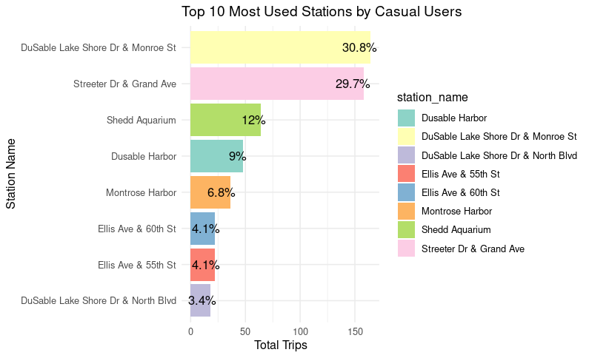
Stations most used
The most used stations by casual users are located in strategic areas, tourist zones, restaurants, universities, schools, parks, and busy roads.
It would be strategic to place signage, special discounts, or promotional events near these stations to encourage the conversion of casual users into anual members.
Improving service or the availability of bycicles at these stations during peak hours could also be considered.

Slide 8
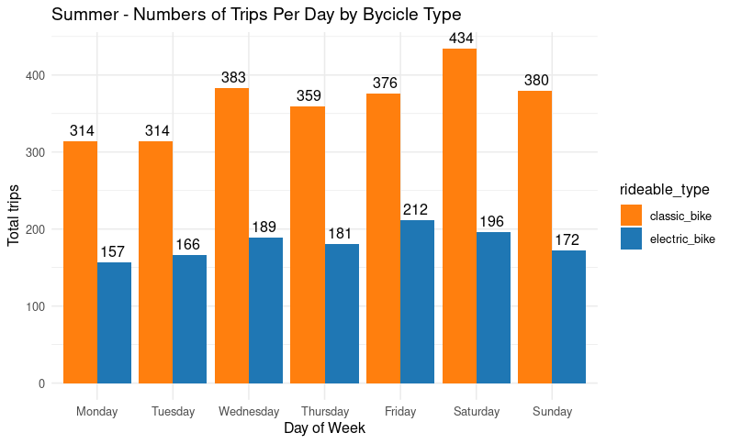
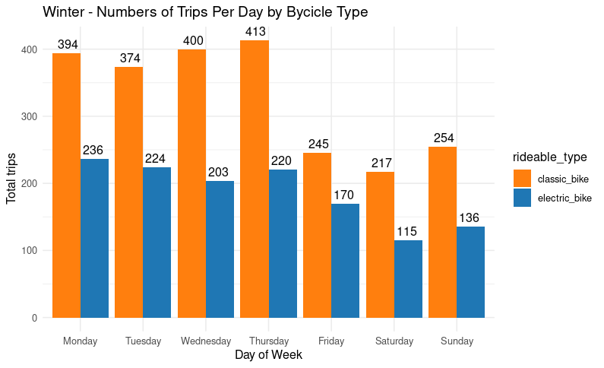
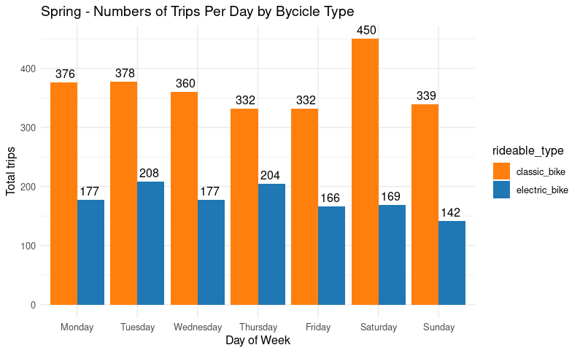
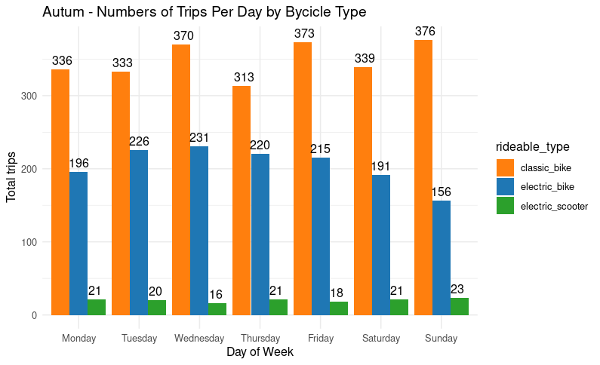
Types of bicycles
• Scooter usage is marginal throghout the year, so they do not represent a main focus for current comercial strategies.
• Classic bikes are the public’s favorite in all seasons, especially on Saturdays during spring and summer, suggesting a strong recreational preference on weekends and in pleasent weather.
• Electric bikes show a more marked use in autum and winter, specially during the first few weekdays in winter. This could be due to their ability to facilitate commutes in harsher conditions. Appealing to a more commited audience or those using them for daily transportation.

Slide 9
Some general conclusions and recommendations
Some general conclusions
•Casual users show a strong presence on weekends and in tourist areas.
•Members primarily use bicycles for daily transportation.
• There is a clear opportunity for winter campaigns and promotions and on weekends during other seasons.
•Classic bicycles dominate usage, followed by electric bicycles on cold workdays.
Some reccomendations
•Offer winter discounts to encourage memberships.
• Place signage and promotions at stations with high casual use.
• Improve bike availability during peak hours and on weekends.
• Focus marketing campaings on classic and electric bikes.

Slide 10
Thank you for your attention.
Prepared by: Alex Inderkum – April 2025

